Slide 1

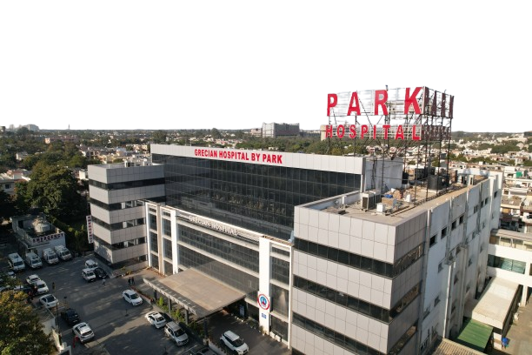

Slide 2
Welcome
Esteemed Guests & Members of the Media
to the
Press Conference of
Park Grecian Hospital, Mohali

Slide 3
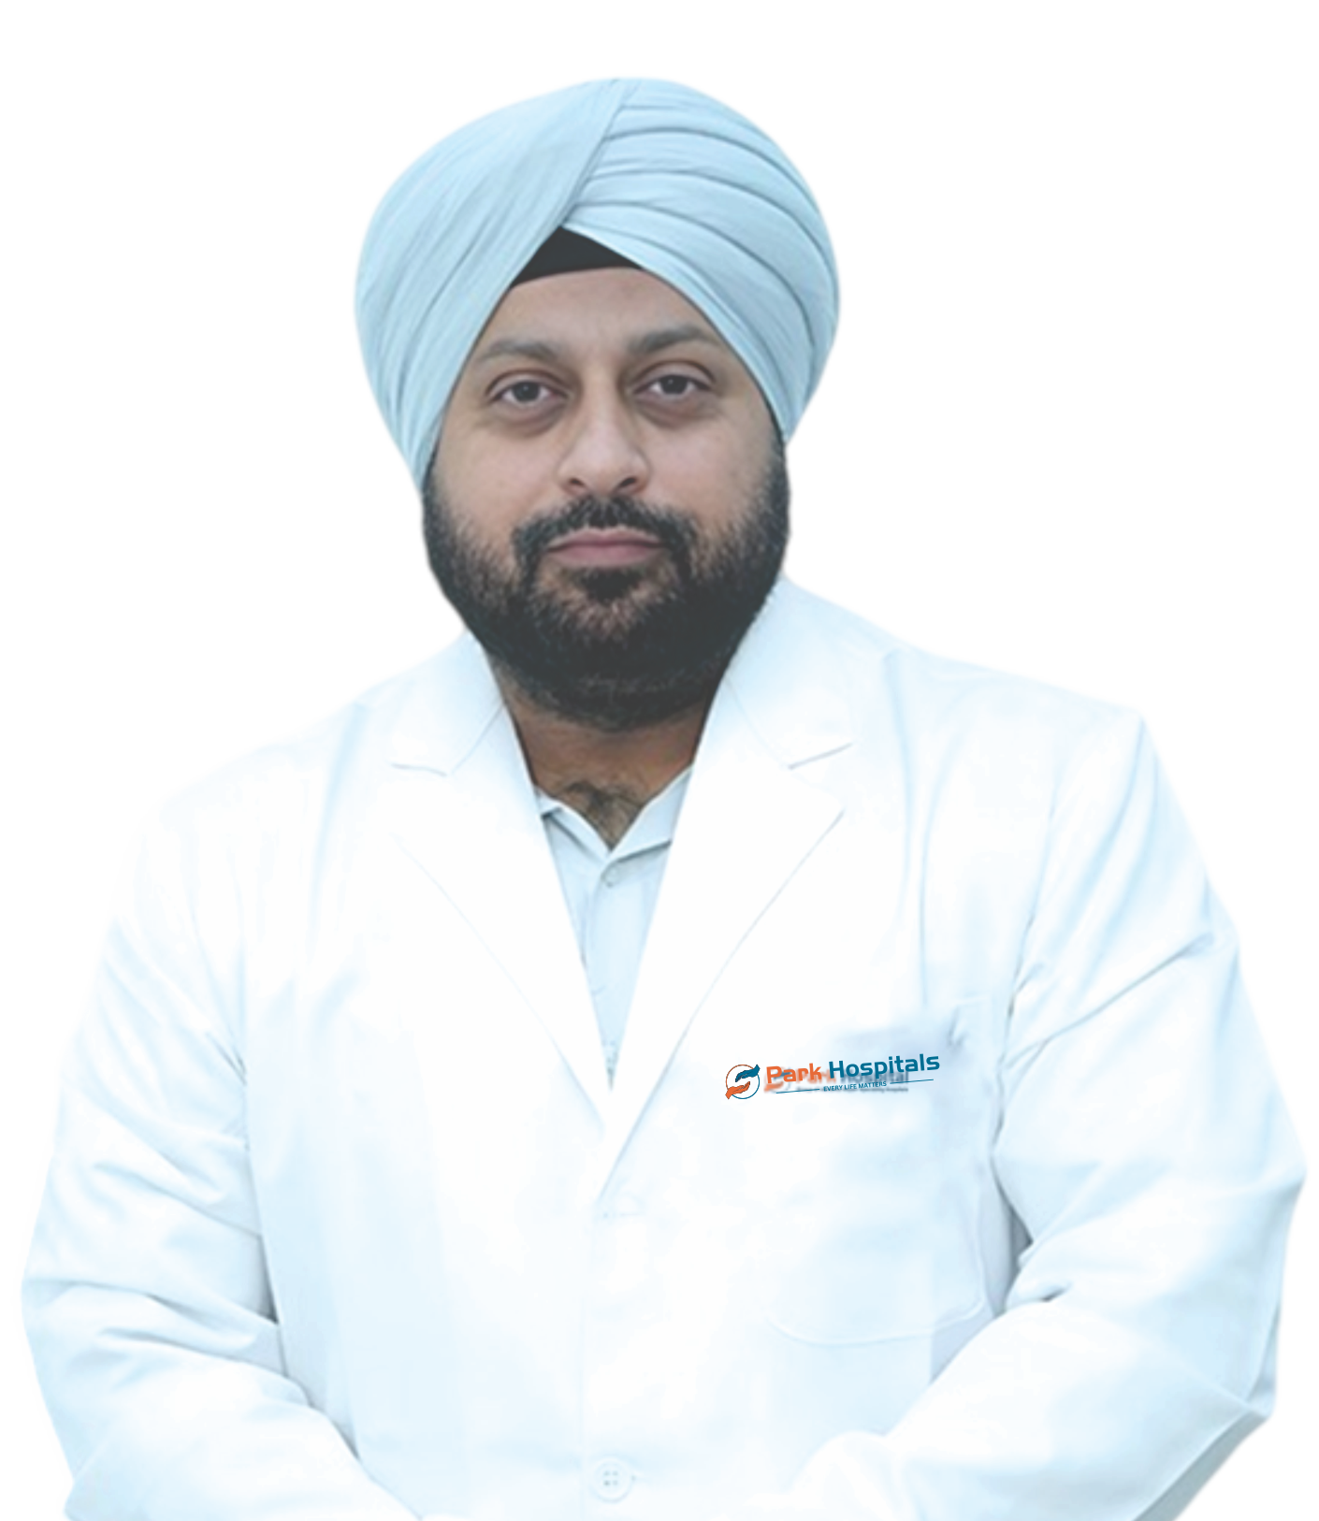
Dr. Bhanu Pratap Singh Saluja
Chairman and Director – Robotic Arthroplasty Centre of Excellence (RACE)
MBBS, MS (ORTHO), FIJR (GERMANY) ,
FIJR (U.K.) , FIJR (AUSTRALIA)

Slide 4
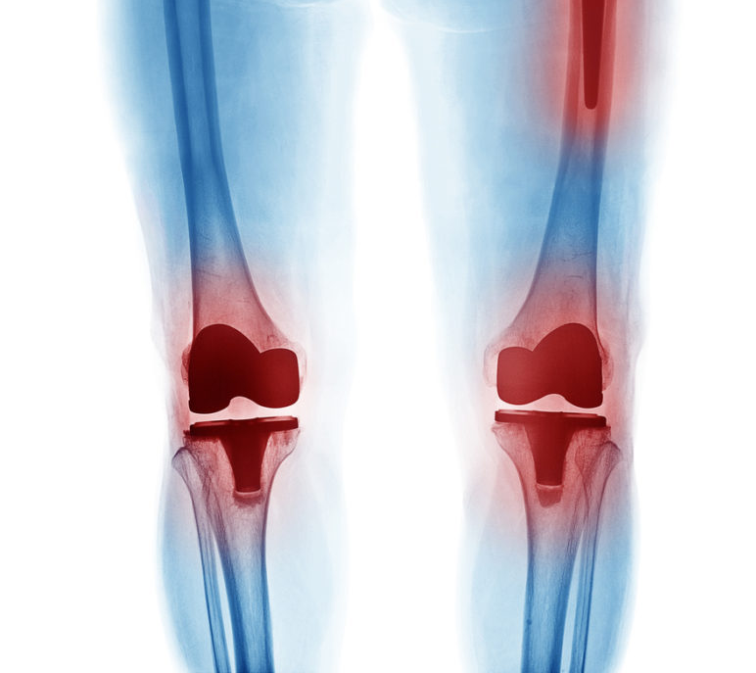
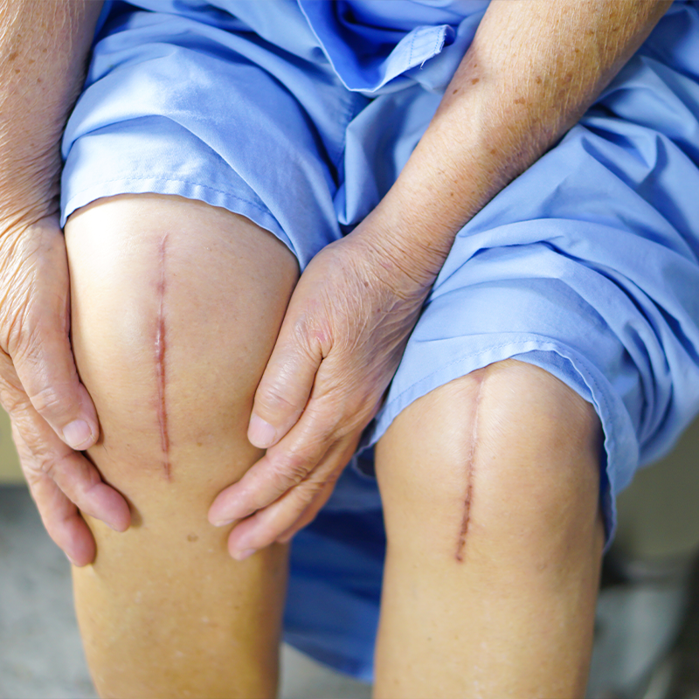
RECENT TREND & ADVANCEMENT IN JOINT REPLACEMENT

Slide 5
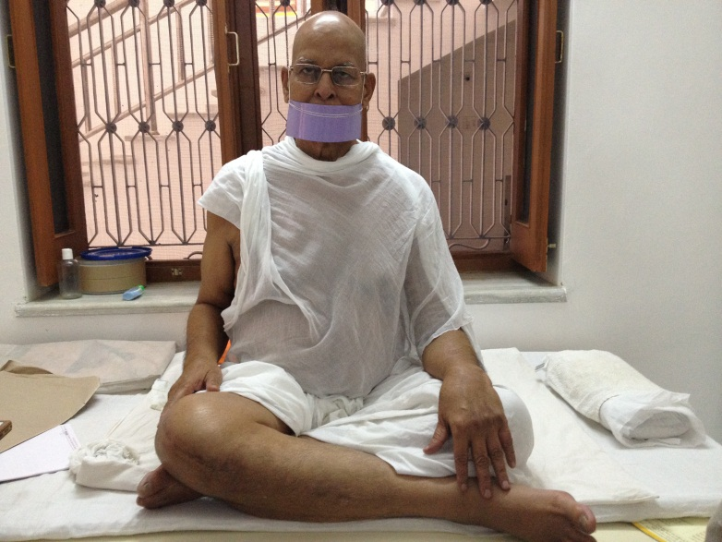
LIFE IS MOVEMENT &
MOVEMENT IS LIFE
POSSIBLE ONLY WITH HEALTHY JOINTS

Slide 6
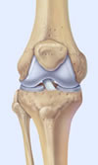
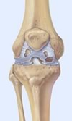
Osteoarthritis (OA) -
The normal cartilage lining is gradually worn away and the underlying bone is exposed.

Slide 7
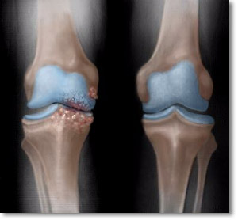
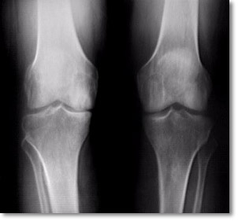
OA – Radiographic Diagnosis
Asymmetrical joint space narrowing from loss of articular cartilage.
The medial (inside) part of the knee is most commonly affected by osteoarthritis.

Slide 8
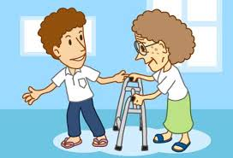
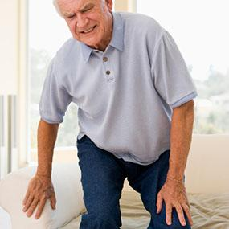
COMPLAINTS
PAIN
DIFFICULTY IN WALKING
SWELLING
STAIR CLIMBING

Slide 9
^{Age}
^{Female gender}
^{Old injury}
OA – Risk Factors

Slide 10


Slide 11
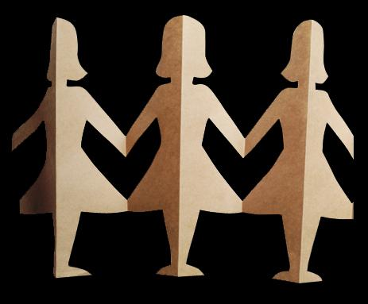
Risk factors you cannot change
Family history of disease
Increasing age
Being female

Slide 12
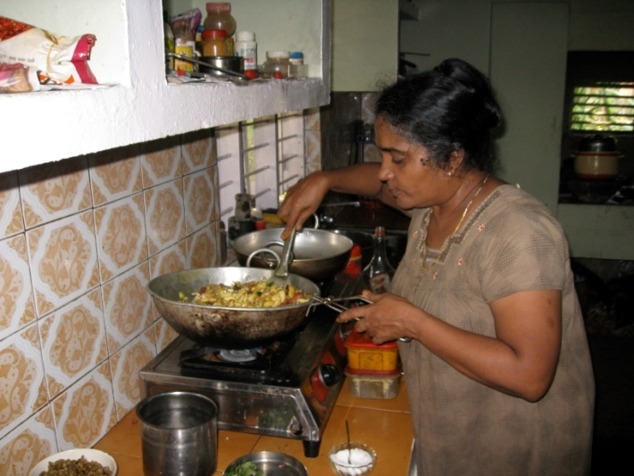
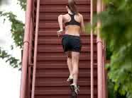
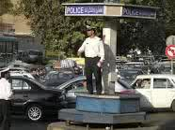
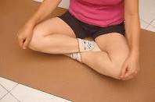
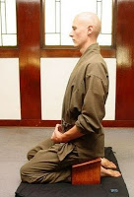
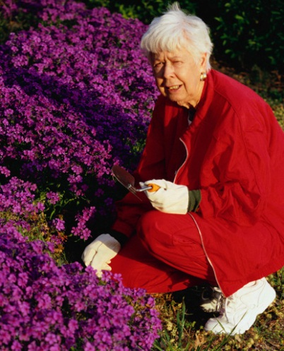
Risk factors you can change
Overuse of the joint

Slide 13
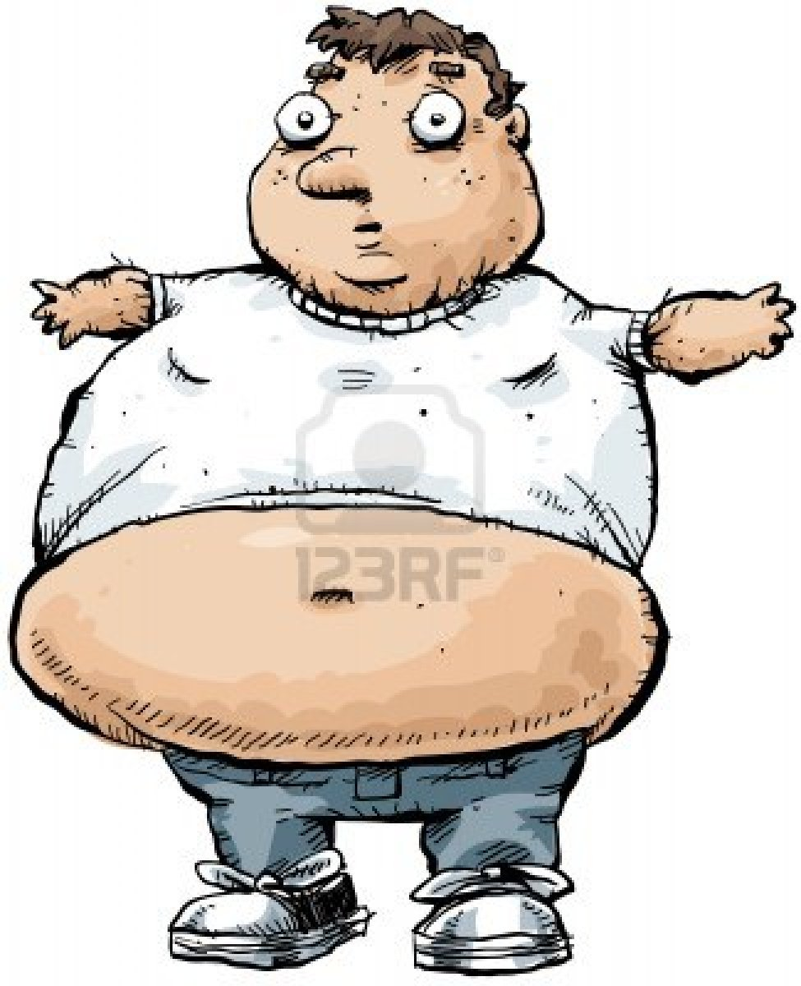
Risk factors you can change
Overweight

Slide 14
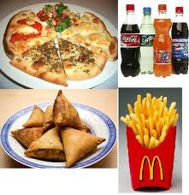
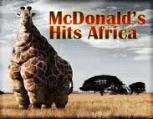

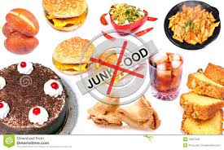

FOOD AND ARTHRITIS
AVOID FIZZ AND CHEESE
OR ELSE………

Slide 15

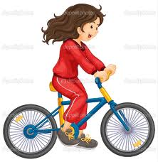
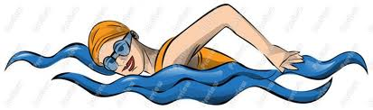
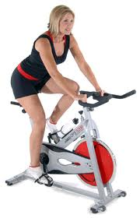
SO WHICH EXERCISES ARE GOOD FOR YOU
CYCLING
SWIMMING
WALKING

Slide 16
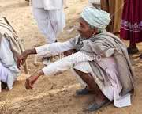
BUSTINGS THE AGE OLD MYTHS
WALKING INCREASES ARTHRITIS
STAIR
CLIMBING
STANDING
FOR
LONGTIME
SQUATTING

Slide 17
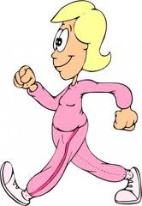
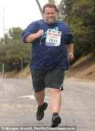
BUSTINGS THE AGE OLD MYTHS
JOGGING IS GOOD FOR KNEE
YES FOR A LEAN PERSON
NO FOR OBESE

Slide 18
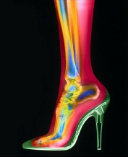
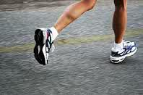
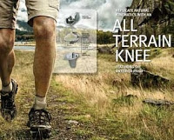
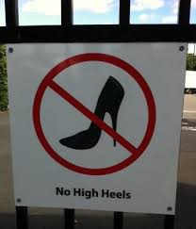
USE PROPER FOOTWEAR

Slide 19
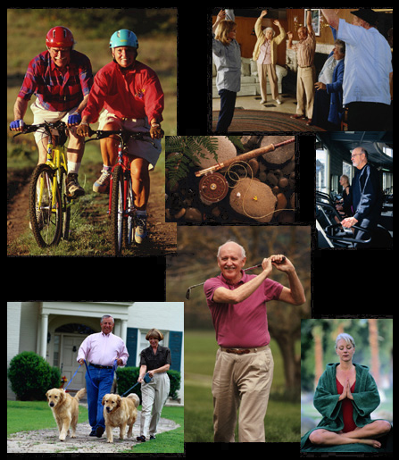
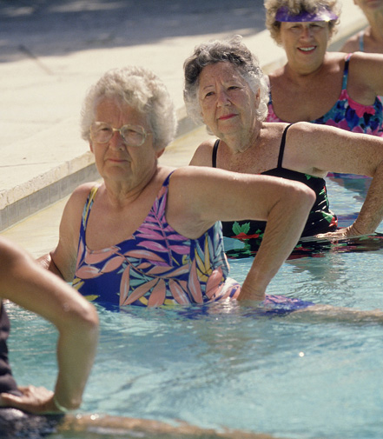
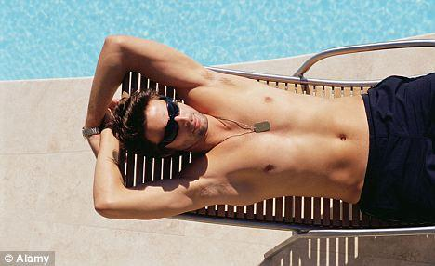
SUN-LIGHT EXERCISE IS IMPORTANT

Slide 20
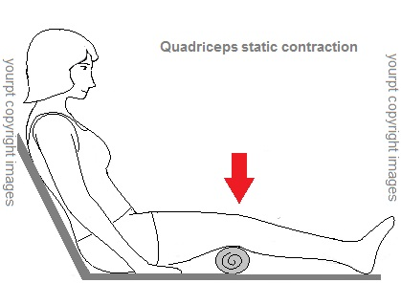
EXERCISES

Slide 21
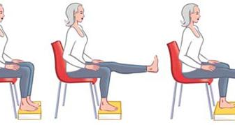
DYNAMIC EXERCISES

Slide 22
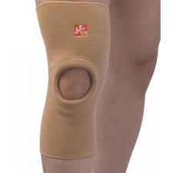
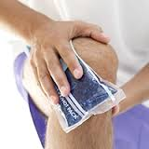
SUPPORTIVE THERAPY- KNEE CAP AND HOT FOMENTATION

Slide 23
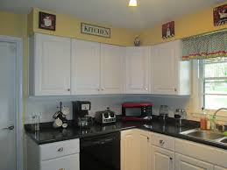
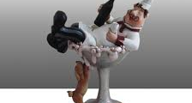
Sitting kitchen

Slide 24

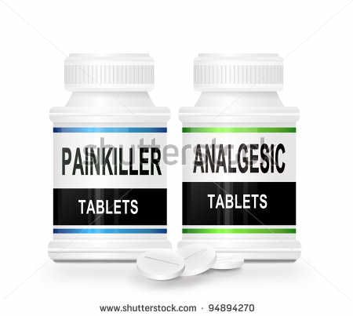
MEDICAL THERAPY
PAIN KILLERS
LOCAL GELS
CALCIUM
VITAMIN D
CARTILAGE NUTRITION eg. GLUCOSAMINE AND CHONDROITIN SULFATE

Slide 25
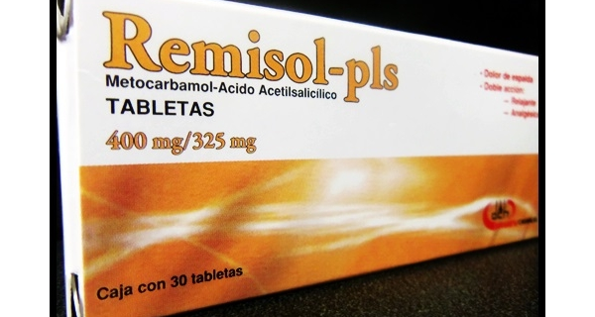
REMISOL

Slide 26
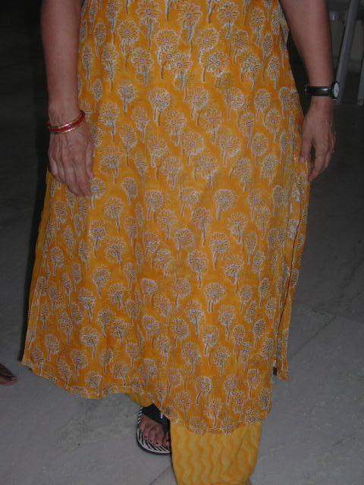
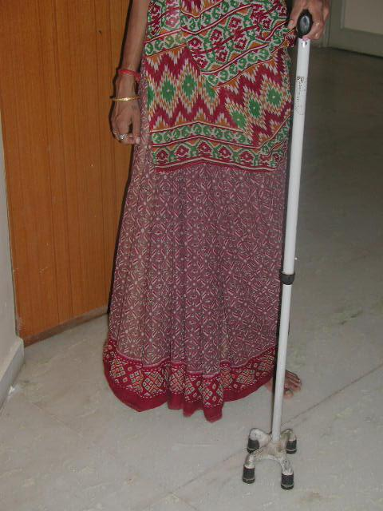
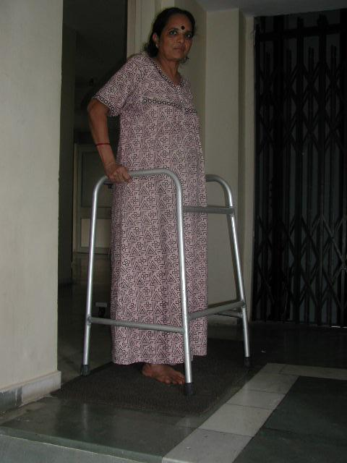
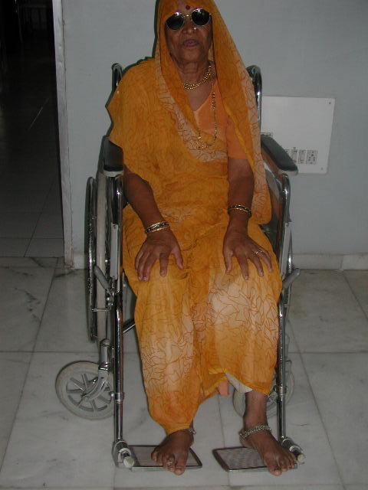
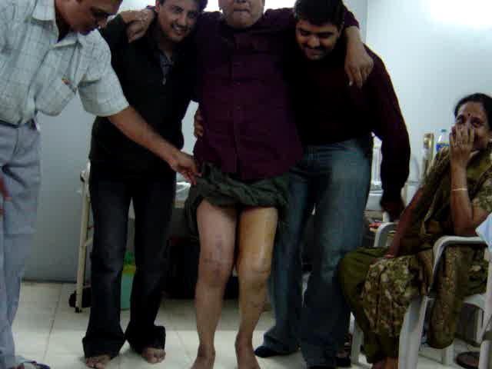
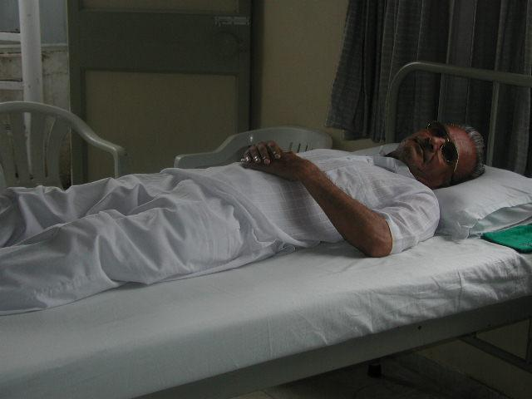
STAGES OF ARTHRITIS

Slide 27

Late Osteoarthritis
TOTAL KNEE REPLACEMENT
What
When
Where

Slide 28
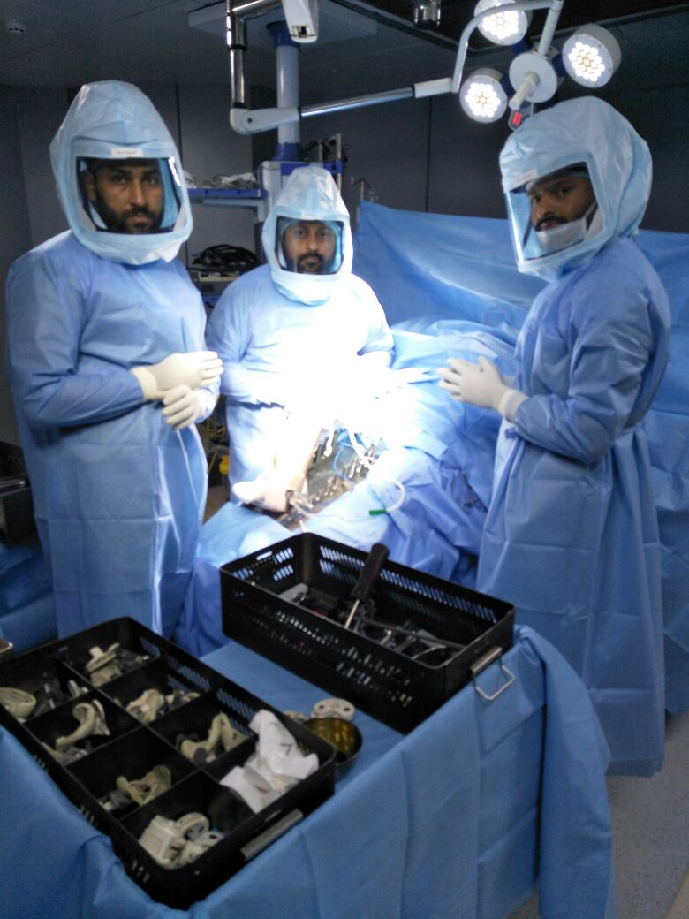
Class 100 Theatre & Space Suit

Slide 29

Stitchless knee replacement
Minimum Incision
Minimum Blood Loss
Walk in 6 hours post surgery
Minimum surgery time
Less Pain
More Flexibility
Minimum Therapy
Climb stairs of 3rd day
Zero infection rate
NextGen* Robotics

Slide 30



Slide 31



Slide 32
PAIN GOES AWAY
LEG BECOMES STRAIGHT
WHAT TO EXPECT AFTER SURGERY

Slide 33
SIT CROSS LEGGED
JOGGING
STAIRS
THINGS ONE CAN DO AFTER TKR

Slide 34
THINGS TO AVOID AFTER SURGERY
SITTING ON THE FLOOR

Slide 35


Achievements
Recipient of Aarogyam Award(2021-22) from Dr. Mansukh Mandaviya, the Minister of Health & Family
Awarded JEWELS OF PUNJAB award by
Shri Nitin Gadkari ji
2024

Slide 36


Happy Patient from Kashmir

Slide 37



Slide 38


Slide 39


